Slide 1
Anselm of Canterbury
Prayers and Meditations
The Proslogion

Slide 2
About the texts
Both composed during Anselm’s tenure as prior of Bec Abbey (1063-1078).
The Proslogion is from 1076; most, though not all, of the prayers are from slightly earlier in the same decade.
While Anselm is chiefly remembered for the Proslogion argument today, throughout Anselm’s lifetime and shortly after, the Prayers and Meditations were Anselm’s most widely circulated work.

Slide 3
The Prayers and Meditations Initial Reception
Almost immediately after Anselm’s death, the genuine collection of Anselm’s prayers and meditations began to be added to. By the 17th c., over 111 prayers and meditations circulated along with the genuine works! It wasn’t until the 1920’s that the collection of genuine works was trimmed down to 19 prayers and 3 meditations, by the Benedictine Dom Andre Wilmart

Slide 4
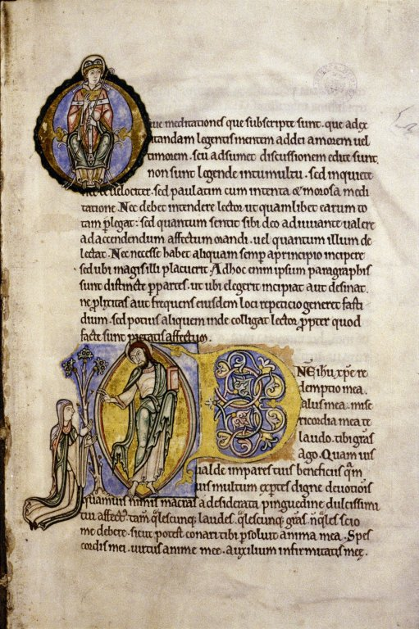
The Prayers and Meditations - Initial Reception (cont.)
Three important manuscripts:
MS Rawlinson 392: a late 11th c. copy of most of the prayers, the three meditations, and the Proslogion
MS Bodley 271, an illuminated manuscript from 12th c. Canterbury
MS Auct. D 26, “Perhaps the earliest English example of a mediaeval text being illustrated during the author’s lifetime” (Pacht 1956, 68).
The punctuation of the manuscripts gives us a clue as to how the manuscripts were read aloud.
Probably the earliest case of a collection of prayers circulating under the name of a living author.

Slide 5
The Prayers and Meditations (cont) Their General Character
Intensely emotional, aiming at the generation of pathos: foreshadows many aspects of the devotio moderna.
Emphasis on Christ’s humanity and suffering.
Characteristics of the Saints described in some detail.
Heavy use of chiasm and parallelism, after the fashion of the psalms.
For private devotion, rather than public: most of the prayers first circulated among noblewomen.

Slide 6
The Prayer to Christ Main themes
The inadequacy of creaturely worship
The debt owed by Christ to his faithful
The memory of Christ’s suffering and sympathy with that of his saints.
Sinfulness as omission, forgetting, absence
The absence of God, and the transience and gloom of earthly existence

Slide 7
The Prayer to Christ excerpt
Kindest, sweetest, most peaceful one:
When will you make up to me:
That I did not see that blessed incorruption of your flesh;
That I did not kiss the place of those wounds,
The fixtures of those nails;
That I did not sprinkle those scars,
Testaments to a true body,
With tears of joy?
Wondrous, measureless, matchless one:
When will you have consoled me?
And when will you unshackle me from my grief?
For my grief shall not attain its course,
As long as I am in exile from my lord.
Woe to me, O Lord, woe to my soul!
My life’s comforter, you departed,
And did not bid me farewell;
Walking along the path, you blessed your disciples,
And I was not present;
Raising your hands, you were taken up by a cloud into heaven,
And I did not see;
Angels promised your return,
And I did not hear.

Slide 8
Proslogion 2-4
What does it prove?
That God exists (c. 2)
That God cannot be thought not to exist (c. 3)
That fool can only say that there is no God so long as he remains a fool (c. 4)

Slide 9
The argument of Proslogion 2 in summary
God is that than which nothing greater can be thought
That than which nothing greater can be thought exists in reality
Therefore, God exists.
Proof of 2: Assume the contrary
Whatever can be thought exists in the mind
And that than which nothing greater can be thought can be thought
Therefore, that than which nothing greater can be thought exists in the mind (5, 6)
Therefore, that than which nothing greater can be thought exists only in the mind (4, 7)
But what exists only in the mind is not as great as what also exists in reality.
And I can think of a being in all respects identical to the previous, except also existing in reality
Therefore, that than which nothing greater can be thought is not as great this other thinkable.
Therefore, that than which nothing greater can be thought is not that than which nothing greater can be thought (9, 10, 11).
Therefore, assumption 4 must be rejected

Slide 10
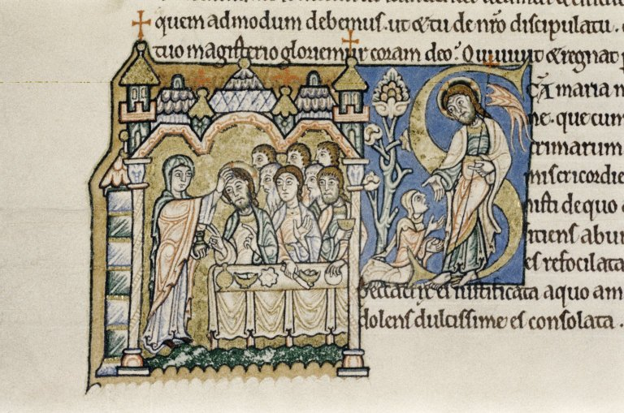
Questions?

